Slide 1

Proposed Recommendations for the impact of Covid 19 on UK Healthcare service delivery
Week 5
Exploring how Covid 19 can be implemented to achieve appropriate results yet minimises disruptions to healthcare services provision

Slide 2

Module lecturer-Tayo Alebiosu
Health and Social Care
Contact me: tayo.alebiosu@lsclondon.co.uk

Slide 3
Aim:
To explore how Covid 19 can be implemented to achieve appropriate results yet minimises disruptions to healthcare services provision
Learning Outcomes:
At the end of this session , students will be able to:
Identify case study Hypotheses.
Evaluate the impacts of Covid 19 on the health and care system’s using the NHS as a National key perspective
Hypothesize potential outcome by putting forward recommendations for the impact of Covid 19 on healthcare service delivery
Explain how Covid 19 can be implemented to achieve appropriate results yet minimises disruptions to healthcare services provision.

Slide 4

LO1-Activity- Video Presentation (5 mins)
Identify steps To Formulate Hypothesis.
https://youtu.be/PCgLjDDD4ek
Feedback to the class

Slide 5

A research hypothesis
A research hypothesis is a specific, clear, and testable proposition or predictive statement about the possible outcome of a scientific research study based on a particular property of a population, such as presumed differences between groups on a particular variable or relationships between variables.
A hypothesis is an assumption, an idea that is proposed for the sake of argument so that it can be tested to see if it might be true.
A hypothesis has classical been referred to as an educated guess. In the context of the scientific method, this description is somewhat correct.
After a problem is identified, the scientist would typically conduct some research about the problem and then make a hypothesis about what will happen during his or her experiment.

Slide 6

Purpose of a hypothesis
A better explanation of the purpose of a hypothesis is that a hypothesis is a proposed solution to a problem. Hypotheses have not yet been supported by any measurable data

Slide 7
Examples of Hypothesis:
1. If I replace the battery in my car, then my car will get better gas mileage.
2. If I eat more vegetables, then I will lose weight faster.
3. If I add fertilizer to my garden, then my plants will grow faster.
4. If I brush my teeth every day, then I will not develop cavities.
5. If I take my vitamins every day, then I will not feel tired.
6. If 50 mL of water are added to my plants each day and they grow, then adding 100 mL of water each day will make them grow even more.

Slide 8

LO2 Activity
Individually, research the impacts of Covid 19 on the health and care system’s using the NHS as a National key perspective.
Feedback by explaining your findings

Slide 9

Now….Lets evaluate Impact of COVID-19 on NHS England as a National key perspective on the health and care system’s

Slide 10

Impact of COVID-19 on NHS as a National key perspective
Impact of COVID-19 on patient care in the NHS in
England
The COVID-19 outbreak has had a huge impact on core NHS services. In order to free up enough capacity to deal with the initial peak of the pandemic, the NHS was forced to shut down or significantly reduce many areas of non-COVID care during April, May and June 2020.
This, combined with fewer patients seeking care during lockdown, means that there has been a significant drop in elective procedures, urgent cancer referrals, first cancer treatments and outpatient appointments

Slide 11

Impact of COVID-19 on patient care in the NHS in England
The full impact of this drastic reduction in routine NHS care in England is only now emerging. Millions of patients living with health problems (including life-threatening conditions such as cancer) have been affected, with their treatment postponed or cancelled.
And millions of patients will have missed vital opportunities to receive initial assessment and diagnosis for health problems in the first place. This is the hidden impact of the COVID crisis – patient safety is being severely compromised not just by the virus itself, but by the knock-on effects of an unprecedented disruption to NHS services.

Slide 12
Impact of COVID-19 on patient care in the NHS in England (cont.…)
This outcome was avoidable. Although a pandemic on the scale of COVID-19 was always likely to cause major disruption to health services, the drastic extent to which the NHS had to shut down routine care is a consequence of over a decade of underinvestment and (in the case of public health and social care) cuts to services.
As a result, NHS capacity has lagged behind many other EU countries, including in terms of bed numbers, critical care facilities, workforce numbers (with 10,000 medical vacancies in the NHS in England in 2019) and resources in primary and community care. The NHS was already in crisis before the pandemic hit, as the BMA consistently warned.
As the NHS begins the vital task of reopening non-COVID services, it now faces a huge backlog of unmet patient need, with patients now facing long waits for treatment.

Slide 13

LO2 Activity (10 minutes)
In your department as a healthcare assistant/ social worker/ nurse/ dental nurse/ health visitor/ occupational therapist/ etc.
How can you minimize the disruption of service caused by Covid 19 on the provision of care services?

Slide 14

The NHS needs:
Honesty and clarity from government about the size of the backlog and how it is going to be managed – in real practical terms
Assurances that there is a credible plan in place to the NHS through this incredibly difficult period, including increasing funding for the coming years above previous spending plans
A package of support for NHS staff, who have consistently gone ‘above and beyond’ so far during the crisis.

Slide 15

The NHS needs: (Cont.…)
Doctors and other healthcare workers have been going above and beyond to ensure the NHS can cope with the pandemic, and this means they have been working in intense and stressful environments for many weeks.
Bank holidays have been cancelled for many doctors. It is vital therefore that step are taken to safeguard the wellbeing of healthcare workers as part of this phase of the NHS’s response.
the NHS will only be able to cope with balancing Covid and non-Covid work if there is an accompanying strong focus on tracking and containing the virus in the community, and if local public health services are supported to lead this.

Slide 16

The following ten principles must be followed as the NHS restarts more non-Covid care:
1. A realistic and cautious approach to balancing Covid and non-Covid capacity is needed
The coming months will require the NHS to maintain a difficult balance between continuing to provide care for patients with Covid-19 whilst ensuring that as far as possible, services stopped or delayed due to the outbreak can begin again.
This will be challenging due to the scale of the changes that have been required so far to ensure the NHS can cope with the pandemic, and there are a number of risks and challenges that will need to be carefully navigated.
These non-Covid critical care patients will clearly need to be kept physically separate from those with the disease, so separate zones or even sites (each with their own staff) will be needed, further stretching resources.
Planning will therefore need to be robust to ensure that critical care units do not become rapidly overwhelmed by coincident reductions in capacity and increases in elective and urgent care demand.

Slide 17

2. There must be adequate PPE for health and care workers, and measures in place to prevent the spread of the virus within the NHS
Health care and other frontline workers have in a majority of cases not been supplied with the PPE they need to protect themselves and patients during the course of the outbreak.
A sufficient, guaranteed supply of PPE for healthcare workers to account for COVID-work, and for restarting non-COVID care with additional precautions in our “new normal” world, is essential.
For example, there will need to be sufficient PPE for staff use in general practice, outpatients and also for diagnostic, operating theatre, catheter laboratories and endoscopy suites.
There also needs to be appropriate PPE available (such as masks and eye protection) for patients using non-Covid services, to reduce the risk of transmission within the NHS.
There will need to be new or updated guidance on the appropriate PPE and infection control procedures that are relevant to the settings in which non-COVID treatment will take place.
In implementing new or amended guidance consideration needs to be given to the loss of trust that the failure to provide adequate PPE has caused amongst health and care workers. Communication and engagement will be imperative to build and restore confidence amongst staff.

Slide 18
3. Decisions about staffing levels and redeployment must be safe and made in consultation with employee representatives
The NHS should set out clear and transparent plans for whether and how it intends to continue to deploy/ redeploy staff across geographies and NHS services and sectors.
Decisions on redeployment must always take into account staff individual circumstances and preferences, as well as skill mix and educational/training requirements. Redeployments are voluntary and therefore must have the express consent of the staff being asked to redeploy.
The NHS should seek to increase recruitment where understaffing persists. This includes for both COVID and non-COVID care, e.g. the urgent and elective backlog in secondary care and the hidden poorly staffed conditions within the community that are yet to be identified.

Slide 19

4. Measures must be taken to safeguard staff wellbeing
Following intensive levels of high workload employers need to ensure that staff are able to take time off and those who would like to work flexibly are supported.
A consistent and fair policy for staff using annual leave entitlement is needed which ensures that those who have worked for an extended period during the pandemic are able to take a break when they need it most.
In secondary care, staffing rosters must have cover for annual and sick leave built in to prevent unrealistic expectations of service capacity being built up.
This should include appropriate consideration of the staffing required to meet adjustments to services and working patterns, as hospitals and other care settings return to providing routine and elective care.
GP practices should be supported to ensure staff are able to take leave allocations, including bank holidays which were recently cancelled for many practices.

Slide 20

5. Clarity must be given to healthcare workers about their future contractual position, and plans to restore training and career development
Many doctors and other healthcare workers have had to change their working patterns as part of the NHS’s response to Covid. Some of these changes – because they were in response to a true emergency – have been extraordinary, including prolonged periods of duty, short notice changes without any predictability and involving extended periods away from home life, and most junior doctors having their training effectively put on hold ’ .
Roles have been temporarily suspended due to the pandemic – including vital elements of education and training, academic research, study leave, and professional development – wherever possible these should be reinstated.
Alongside this, clarity is needed on how and when training programmes and timely career progression will continue, not just to give certainty to affected doctors in training, but also to ensure ongoing sustainable service delivery.

Slide 21
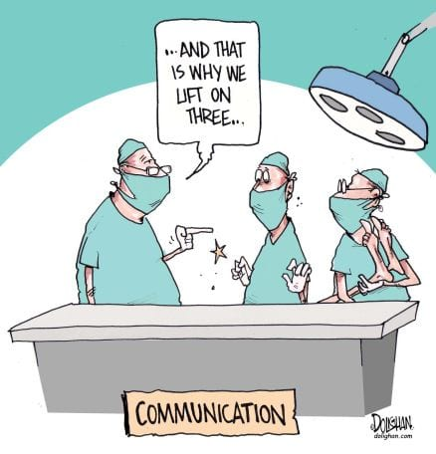
6. There must be effective and transparent public communication so that patients understand what they can and cannot expect from the NHS at this time
Government need to develop a clear and effective communication strategy to inform the public about how and when to access services. Clear and sustained communication is necessary to encourage use of and signpost to urgent treatment – in particular where there are only short-term windows for effective treatment of progressive conditions and notably some cancers.
Early communication is needed to ensure patients accessing care understand how NHS service will be different to what they would have expected before the pandemic. Asking patients to undertake a period of social isolation before operations is likely to be an essential requirement that will need early communication. Clinics will need to adapt to allow social distancing in waiting areas.

Slide 22

Cont.…
Sharing more information with the public about steps being taken to keep them safe if and when they need to use the NHS – such as the use of different zones to keep patients who have or potentially have the disease separate from those who don’t – may help provide reassurance.
Patients need to be reassured that it is safe and appropriate for them seek emergency care from the NHS if they need it, as many appear to be staying away due to concerns about contracting or spreading Covid, or even just not wanting to “burden the NHS” when they know services are stretched thinly.
The NHS will need to become adept on providing clear information to clinicians and patients alike on what services are open, the scope of services available and a timeline for restoration of further services and routes to access them, noting that this will be subject to ongoing change in either direction as the pandemic slows or regains pace.

Slide 23

7. Increased remote working, where clinically appropriate, and use of technology to empower patients should be supported
In primary care there has been an unprecedented shift to remote working, necessitated by the need to reduce face-to-face contact, with most GP consultations now taking place remotely.
Adequate technology will be needed as many settings do not have adequate hardware and bandwidth to undertake this work. This should be funded by the NHS. Gains that have been made in helping people to cope with the pandemic and to empower patients – such as use of befriending apps to reach out to those at risk of having little social contact with others – need to be retained and built on for the future.
While this is set to continue for the foreseeable future, there must be consideration about how to facilitate greater and sustainable remote working across the NHS (including both primary and secondary care) and in social care, where clinically appropriate, even when social distancing rules are relaxed.

Slide 24

8. Local decisions must be guided by clinical expertise and the experience of those working at the frontline
Clinicians should play a central role in determining and guiding the response to Covid-19, to ensure that any response is credible, clinically sound, and based on the needs of both patients and the NHS workforce.
Efforts both to tackle Covid and to restore wider provision of care need to reflect local circumstances, especially in relation to at-risk and vulnerable groups.
Doctors have an invaluable understanding of the populations they serve and the pressures facing the hospitals, GP practices, and community services where they work, therefore, it is essential that they are centrally involved in deciding how local services should now be run.

Slide 25

9. The government must support and significantly enhance local public health services and ensure there is adequate capacity to test, trace and quarantine
Testing of patients must be expanded, particularly for vulnerable patients such as those in residential and nursing care homes, and for patients who are accessing routine care (such as elective surgery) to provide confidence that areas designated for the care of non-Covid patients are not exposed unnecessarily to asymptomatic spread of Covid.
As the restoration of non-covid services moves forward, the Government must put in place a credible and transparent strategy on testing. This should include, but not be limited to, continuing to increase national testing capacity.

Slide 26
NHS Trace and Track (Cont.….)
Alongside this a further significant increase in capacity is needed to enable much more widespread testing of whole communities – including the ability to test potential asymptomatic carriers where evidence suggests there are pockets of infection.
Capacity is also needed to effectively track and prevent further spread of the disease through quarantining those with the virus wherever possible. To achieve this we need to see a significant change increase in funding for local public health services so that they can lead this next phase of the response to the outbreak.

Slide 27

10. A strategy is needed to ensure that restarting non-Covid work does not exacerbate health inequalities
Measures should be considered to mitigate this risk. In the immediate term, national-level action is needed to ensure that where there is variation in access to non-Covid NHS services, mechanisms are in place to enable patients to access services in areas where capacity is available.
Although this may not be appropriate for all patients (particularly if significant travel is involved) for some this could help ensure they receive treatment faster.

Slide 28
Cont.…
As local areas begin to make decisions about whether to restart non-Covid care – e.g. how much elective surgery to schedule – there is a risk that this will create a postcode lottery for patients, with some services available in some areas but not others.
This will exacerbate health inequalities, which are already a factor in the impact of Covid on the UK, and one that is likely to grow if the UK enters an economic recession as is predicted.

Slide 29
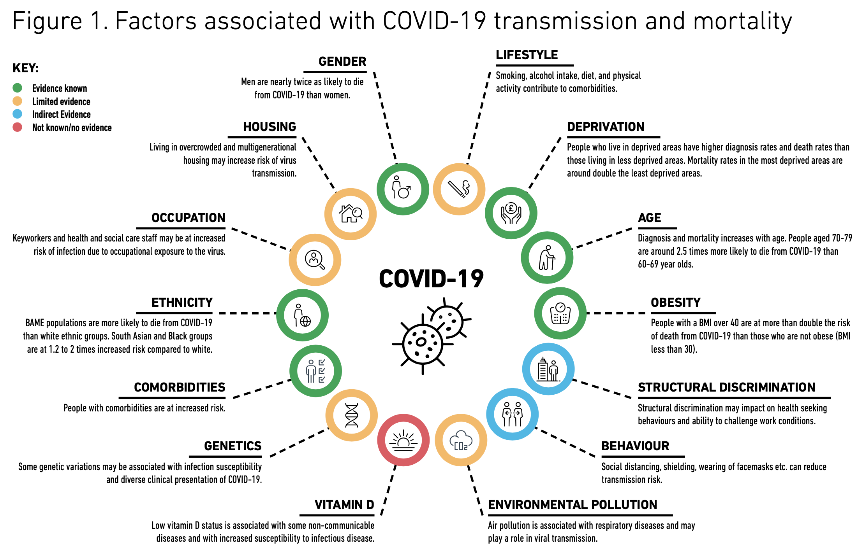
COVID-19 in Black, Asian and Minority Ethnic populations: An evidence review and recommendations from SAHF (2020).
Available at: https://www.sahf.org.uk/covid19

Slide 30

Assessment guide
Open the assessment guide in word document

Slide 31
In conclusion, we have learnt how to:
Identify case study Hypotheses.
Evaluate the impacts of Covid 19 on the health and care system’s using the NHS as a National key perspective
Hypothesize potential outcome by putting forward recommendations for the impact of Covid 19 on healthcare service delivery
Explain how Covid 19 can be implemented to achieve appropriate results yet minimises disruptions to healthcare services provision.

Slide 32
ASSESSMENT SUBMISSION
Date assignment set | 04/01/2021
Submission deadline date | 29/03/2021
Return date to students | 26/04/2021
All assignment will be submitted in electronic format and uploaded to LSC Portal on Turnitin

Slide 33
Reference
Toledo, A., Flikkema, R. and Toledo-Pereyra, L., 2011. Developing the Research Hypothesis. Journal of Investigative Surgery, 24(5), pp.191-194.
The Health Foundation. 2021. Key facts on current state of social care | The Health Foundation. [online] Available at: <https://www.health.org.uk/news/key-facts-on-current-state-of-social-care> [Accessed 19 February 2021].
Bma.org.uk. 2021. [online] Available at: <https://www.bma.org.uk/media/2487/ten-principles.pdf> [Accessed 19 February 2021].
Burkitt, S., 2021. The long-term impact of coronavirus on mental health in Wales. [online] WalesOnline. Available at: <https://www.walesonline.co.uk/news/wales-news/when-going-end-long-term-19738739> [Accessed 19 February 2021].
Simplypsychology.org. 2021. [online] Available at: <https://www.simplypsychology.org/what-is-a-hypotheses.html> [Accessed 19 February 2021].

